Slide 1
WEB FRONT
END DESIGN

Slide 2
WHY??

Slide 3
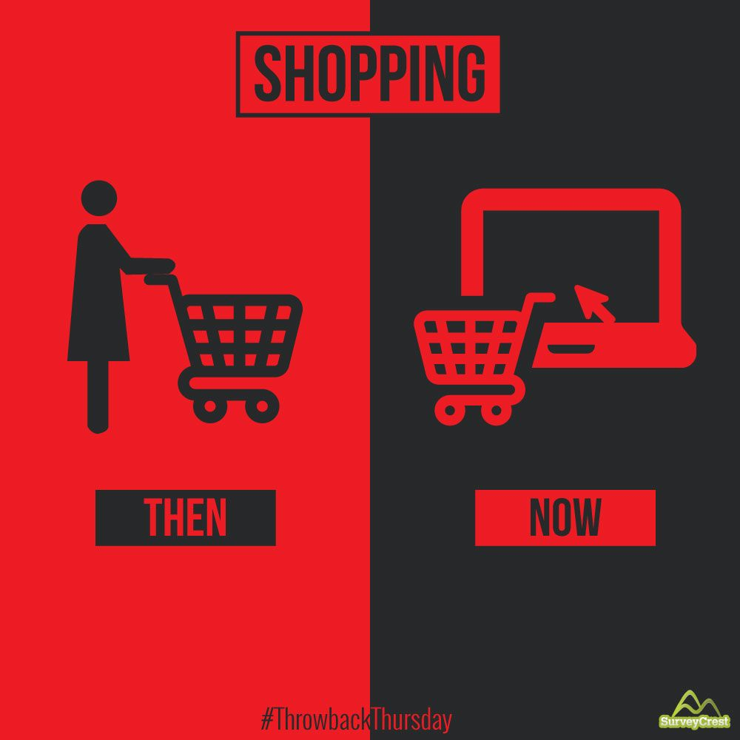

Slide 4
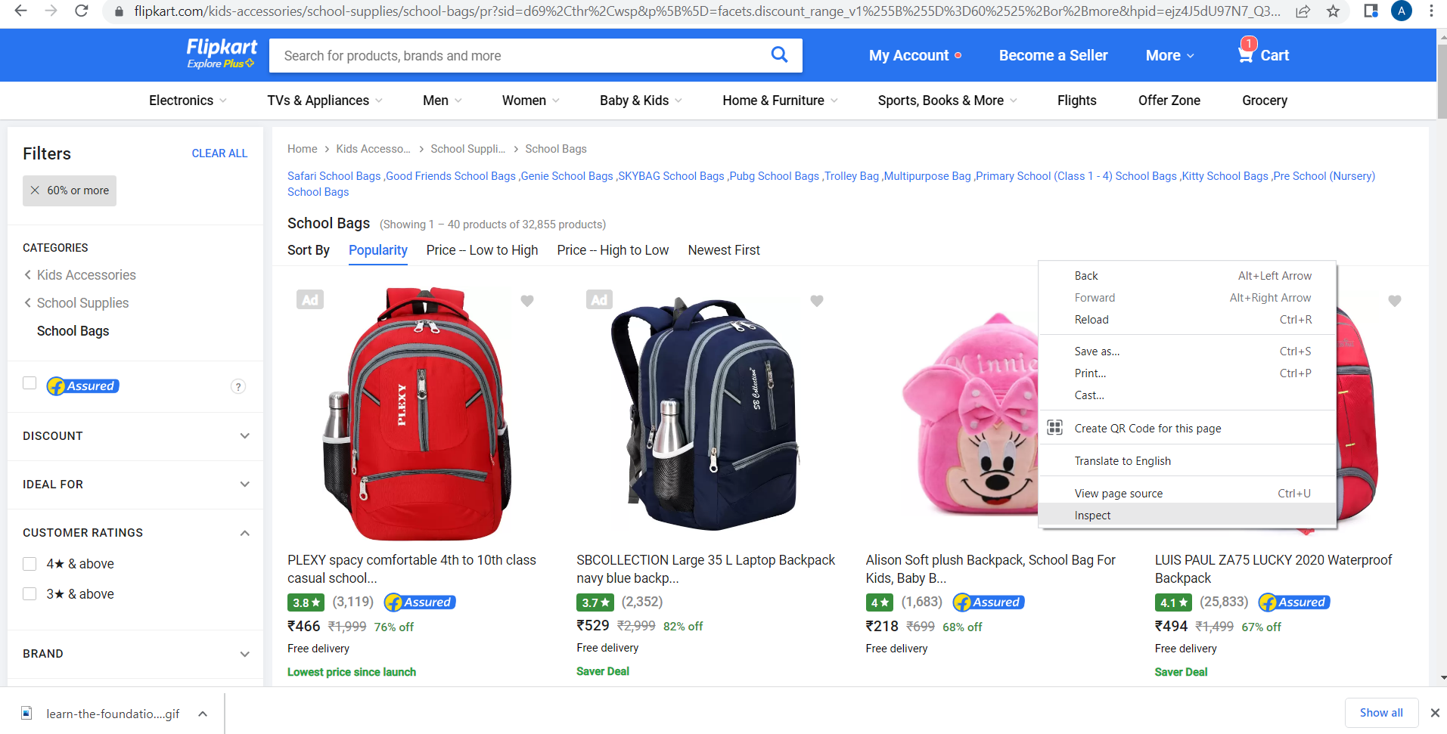

Slide 5
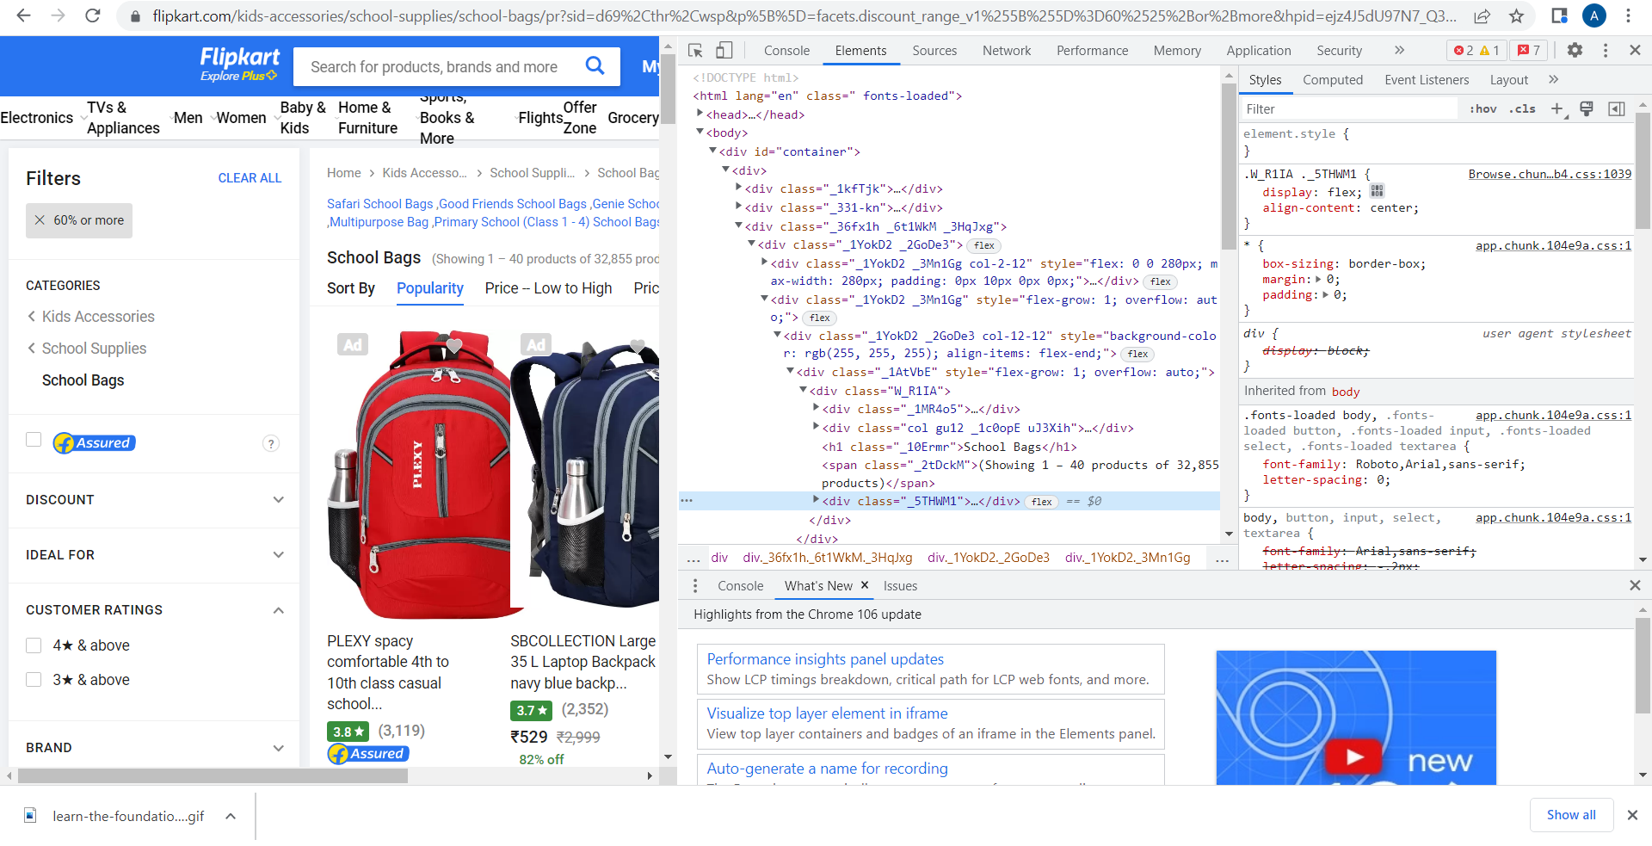

Slide 6
FRONT END DESIGN

Slide 7
1.
HTML
Hyper Text Markup Language

Slide 8
HTML (HyperText Markup Language) is the most basic building block of the Web.
It defines the meaning and structure of web content

Slide 9
WHAT IS A HYPERTEXT ?
Refers to links that connect web pages to one another
Links are a fundamental aspect of the Web.
Every web content is either text,graphic elements or multimedia which can be linked.

Slide 10
WHAT IS MARKUP ?
Data included in an electronic document which is distinct from the actual content.
Markup is often used to control the display of the document or to enrich its content to facilitate automated processing

Slide 11
WHAT IS A MARKUP LANGUAGE ?
A markup language is a computer language to create web pages
Markup means it uses <tags> to define elements and add information. It is not a programming language contains typical syntax to create a webpage.

Slide 12
HyperText Markup Language
The code that is used to structure a web page and its content
It’s set of markup symbols or codes
The markup tells web browsers how to display a web page's words and images

Slide 13
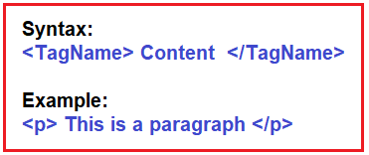
HyperText Markup Language
Each individual piece markup code is referred to as an element.
For each type of content,presentation style and other functionality there exist different html <tags>.

Slide 14
HTML Tags
HTML tags are special words wrapped in angle brackets (< >) which used to define different types of content in a webpage.
Each individual piece markup code is referred to as an element.
For each type of content,presentation style and other functionality there exist different html <tags>.

Slide 15
Anatomy of an HTML document

Slide 16
Anatomy of an HTML document
<!DOCTYPE html>

Slide 17
Anatomy of an HTML document
<!DOCTYPE html>
<html>
<head>
</head>
<body>
</body>
</html>

Slide 18
Anatomy of an HTML document
<!DOCTYPE html>
<html>
<head>
</head>
<body>
</body>
</html>

Slide 19
The anatomy of an HTML element
<tagname>your text/content</tagname>
Notes:
The opening tag: This consists of the name of the element (in this case, p), wrapped in opening and closing angle brackets. This states where the element begins or starts to take effect — in this case where the paragraph begins.
The closing tag: This is the same as the opening tag, except that it includes a forward slash before the element name. This states where the element ends — in this case where the paragraph ends. Failing to add a closing tag is one of the standard beginner errors and can lead to strange results.
The content: This is the content of the element, which in this case, is just text.
The element: The opening tag, the closing tag, and the content together comprise the element.

Slide 20

Let’s code !

Slide 21
Lets create a small website using html tags
Hyper Text Markup Language

Slide 22
We can add additional information to a <tag>
as its Attribute

Slide 23
HTML ATTRIBUTES
Attribute has two parts name and value.
Added within the opening tag after tag name.
The attribute name followed by an equal sign.
The attribute value wrapped by opening and closing quotation marks.

Slide 24

Comment Tag HTML <!--...--> Tag

Slide 25
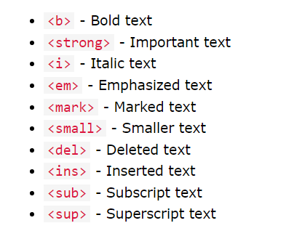
HTML FORMATING TAGS
HTML provides unique tags for representing text data in different markups

Slide 26
Tags for Media Files
HTML defines unique tags for adding media files as contents
To play a youtube video
<iframe width="420" height="315" src="https://www.youtube.com/embed/tgbNymZ7vqY"> </iframe>
Audio - <audio> tag
<audio >
<source src = “file_path” type = “audio/mpeg”>
</audio>
Video - <video> tag
<video>
<source src = “file_path” type = “video/mp4”>
</video>

Slide 27
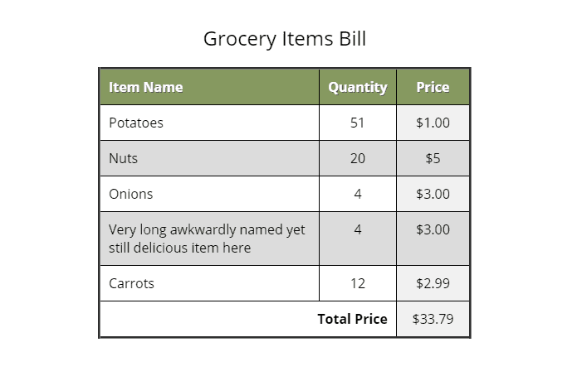
<table>

Slide 28
<table> Tag
Tables are required to display data in rows and columns
The important elements associated with the table tags are
<table> : The main container of table
<thead> : provides separate header for the table
<tbody> : contains main content of the table
<th> : Adds table headings
<tr> : adds table row
<td> : adds table data
<tfoot> : contains separate footer for the table

Slide 29
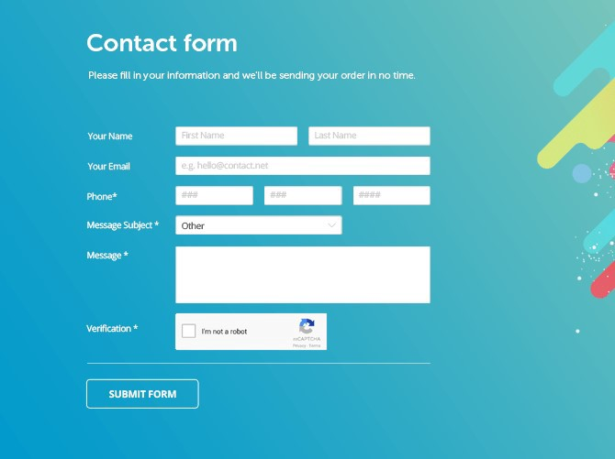
<form>

Slide 30
<form> Tag
Forms are required to take input from the user who visits the website
The important elements associated with the form elements are
<input> : The element where user can type in data
<label> : The information about the input element
<select> : The element defines a drop-down list
<textarea> : The element defines multi-line input field
<fieldset> : The element used to relate form elements
<datalist> : The element specifies a list of predefined options
<button> : The element which defines a clickable element

